Slide 1
Chapter 16

Slide 2
King Cotton
Much like tobacco of colonial days, cotton was a large cash crop that ruined land
Economic spiral -> more slaves -> more land -> more slaves, etc.
Northern industries benefited from cotton
How?
Eli Whitney’s cotton gin increased the need for slavery in the south

Slide 3
Southern Life
South was, in a sense, an oligarchy:
A government by the few
In 1850, 1,733 families owned more than 100 slaves
Dominated Southern politics
South was least democratic area of the US
Huge gap between rich and poor
By 1860, nearly 4 million slaves, quadrupled since 1800…… why?
¼ of white southerners owned slaves, yet most southern whites defended the system
Many hoped they would one day be able to buy a slave or two
They felt racially superior
Higher socially than slaves

Slide 4
Free Blacks: Slaves Without Masters
Free blacks were throughout the South
250,000 in number
Purchased their freedom with earnings from labor after hours
Many southern states passed laws limiting freedoms of free blacks
In the North, they numbered 250,000 as well
Disliked by Irish immigrants. Why?
Faced tension and discrimination anywhere they went

Slide 5
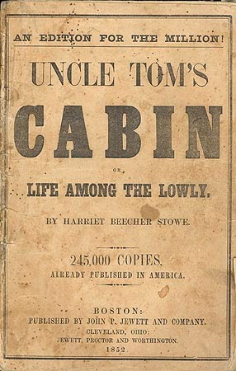
Plantation Slavery
Legal Importation of slaves ended in 1808
Slave Trade Clause in Constitution
Bulk of the increase in population came from procreation
Slaves were sold like animals, and often, with animals at auctions
Families often broken up
Uncle Tom’s Cabin

Slide 6
Harsh Treatment for Slaves
Conditions varied from region to region
Most worked sun up to sun down
No civil or political rights
If few rights were violated, slaves couldn’t testify in court
By 1860, most slaves were in deep South: SC, GA, AL, MS, LA
Distinct new African American culture emerges that combined African and American cultural influences

Slide 7
The Burdens of Bondage
90% of adult slaves were illiterate at start of Civil War
How to “fight back” against slavery?
Worked slowly, broke machines and equipment, running away, etc.
Most common form of resistance, NOT rebellions
Slave Rebellions:
Stono Rebellion: 1739, SC slaves fled to Florida, were unsuccessful
Denmarck Vesey: SC, 1822, planned largest ever revolt, never materialized, hanged with 30 others
Nat Turner: 60 Virginians killed, mostly women and children
Significance of all slave rebellions:
Clamped down on slavery in South, harsher laws and punishments

Slide 8
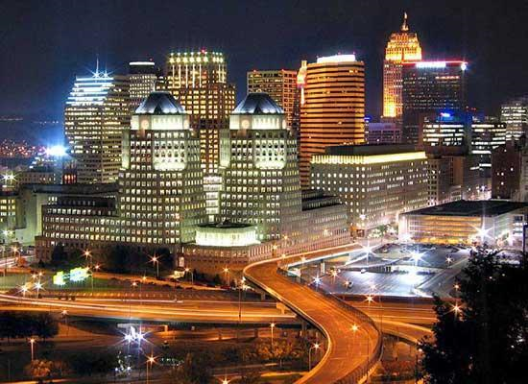
Early Abolitionism
Abolitionism: Movement that demanded an immediate end to slavery
First started during colonial era under Quakers
American Colonization Society:
Focused on transporting Blacks back to Africa
Abe Lincoln, Henry Clay
By 1860, almost all slaves were native-born
1833: Britain ends slavery in West Indies
US one of last places that still allows slavery
American Slavery as It Is – Theodore Dwight Weld, Uncle Tom’s Cabin – Harriet Beecher Stowe, from………………………………..

Slide 9
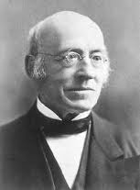

Radical Abolitionism
William Lloyd Garrison (KNOW HIM!!)
Published The Liberator, wanted North to secede from the South
***Immediate and uncompensated end to slavery***
American Anti-Slavery Society
Wendell Philips, would not eat cane sugar or wear cotton cloth
David Walker
Black abolitionist, Appeal to the Colored Citizens of the World, called for a bloody end to white supremacy
Frederick Douglas
Former slave, escaped slavery at age 21
Lectured widely to end slavery, was subject to frequent beatings and threats

Slide 10
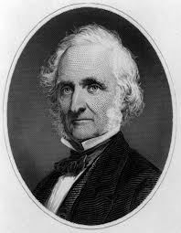
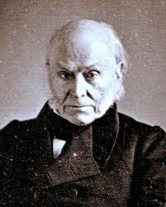
The South Fights Back
By 1830, abolitionist movement in South was silenced
1831-32, VA legislature defeated emancipation propositions
Leads to slave states tightening slave codes
Nat Turner’s revolt coincided with The Liberator
Garrison was viewed as a terrorist, GA offered $5,000 for his arrest and conviction
Gag Resolution
All antislavery appeals were forbidden to be discussed in Congress
Eventually repealed with help of John Quincy Adams
South banned anti-slavery messages in the mail

Slide 13
The Abolitionist Impact in the North
Garrison not embraced in North for a while
Many respected the Constitution and slavery was allowed under it
Southern planters owed $300 million to Northern banks
Fear of money being lost if the Union dissolved
Many Northerners opposed allowing slavery in Western territories. “Free Soilers”

